Slide 1









Senior Project Progress Summary
Embedded IoT Systems · MQTT / Modbus / TIG Stack · Real-Time Web Dashboard
Patthannan B.
Presented to Dr. Rawat | May 2026
Technologies used:
github.com/patthananb/Lab_network_monitoring · github.com/patthananb/IoT-sniffer
1 / 12

Slide 2



Project Overview
ESP32 Weather Station
Web Services
ESP32-S3 Firmware (PlatformIO)
Reads XY-MD02 temp/humidity + SDM120 power via RS485 Modbus RTU
MQTT Publisher
JSON telemetry → Mosquitto broker on Raspberry Pi 4 (2GB)
Modbus TCP Slave
21 holding registers on port 502 — IEEE754 float pairs for all power fields
TIG Stack on Raspberry Pi 4
Dockerized Telegraf + InfluxDB + Grafana dashboards + 7" kiosk
IoT Sniffer
Real-time dashboard on RPi4 — captures & decodes Modbus TCP, MQTT/TCP, MQTT/WS via Python + scapy
Protocol Views
Packet inspector, 3 connection graph views (Sequence/Topology/Matrix), p50/p95/p99 + CDF + jitter
WebSocket Packet Generator (sim.jsx)
Synthesizes realistic Modbus TCP + MQTT traffic for testing and demos without live hardware
Tested Pipeline
36-test pytest suite: BPF filter, frame formatters, summary renderer, pcap replay end-to-end
2 / 12

Slide 3
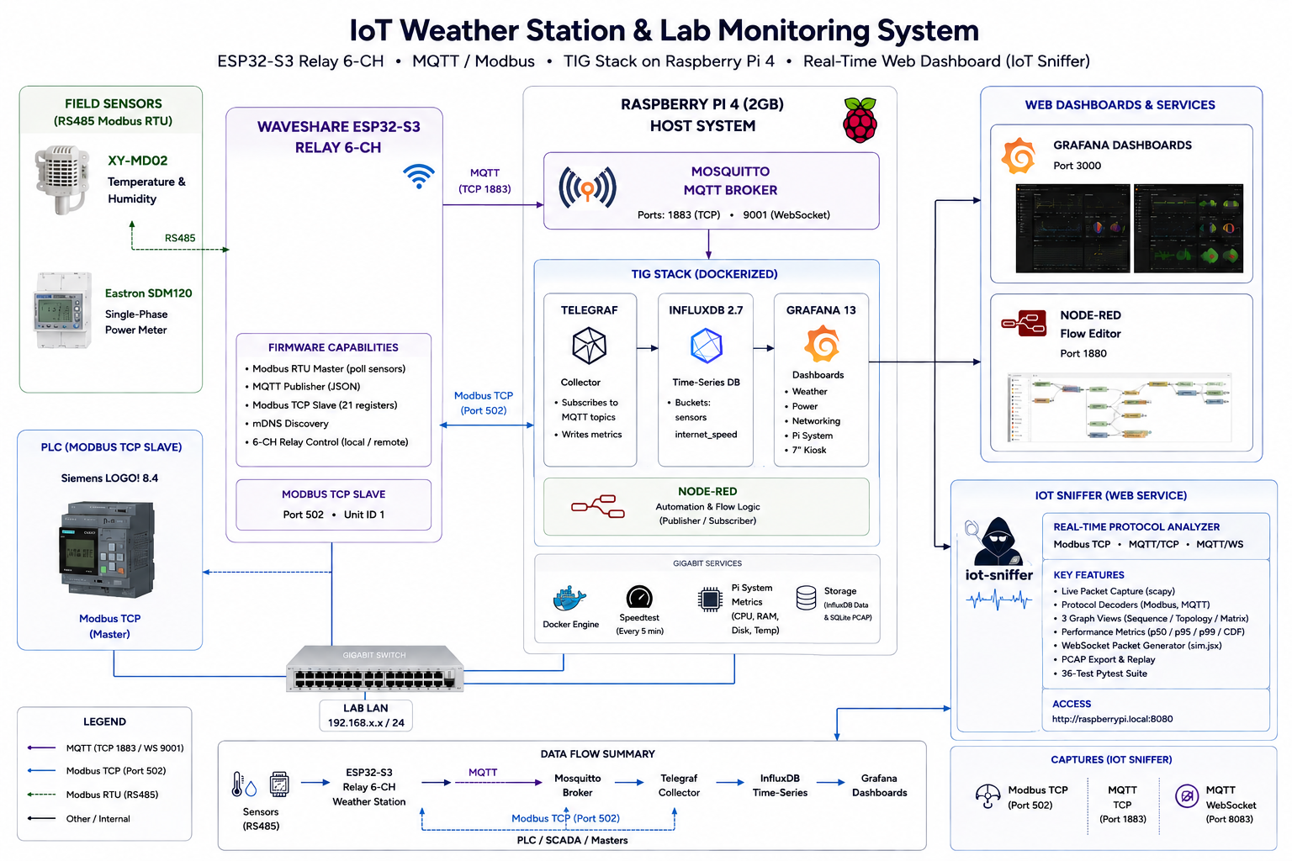
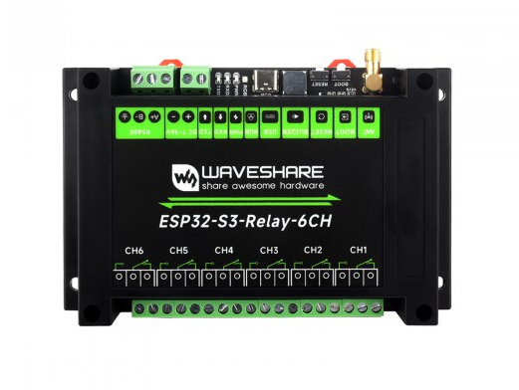

Slide 4

ESP32 Weather Station — Hardware & Firmware
Hardware Components
Firmware Capabilities (C++ / PlatformIO)
ESP32-S3
Modbus RTU Master
Waveshare relay board — WiFi, USB CDC on Boot
Polls XY-MD02 & SDM120 over RS485 every cycle
XY-MD02
MQTT Publisher
RS485 Modbus RTU — temperature & humidity sensor
Publishes JSON to Mosquitto at esp32s3-weather.local
Eastron SDM120
Modbus TCP Slave
RS485 Modbus RTU — single-phase power meter
21 holding registers on port 502 — IEEE754 float pairs
Siemens LOGO! 8.4
mDNS Discovery
PLC — Modbus TCP slave in lab network
Broadcasts esp32s3-weather.local for zero-config LAN access
Raspberry Pi 4 (2GB)
Build Footprint
Host: Mosquitto + TIG stack + IoT Sniffer
Flash 946 KB / 1310 KB (72%) · RAM 48.5 KB / 328 KB (15%)
3 / 12

Slide 5
MQTT Broker & TIG Stack — Raspberry Pi 4 (2GB)
ESP32-S3
Sensor Node
Mosquitto
MQTT Broker
Telegraf
Collector
InfluxDB
Time-Series
Grafana
Dashboard
→
→
→
→
All services Dockerized on Raspberry Pi 4 (2GB) · Uptime: 3+ days · Load avg: 0.44
Mosquitto MQTT Broker
InfluxDB + Telegraf
Grafana + Node-RED
eclipse-mosquitto:2.0 | LAN only
Port 1883 (MQTT/TCP) · Port 9001 (MQTT/WS)
ESP32 publishes temperature, humidity, power_voltage, power_current, power_watts, power_factor, power_frequency, power_energy_kwh
Telegraf subscribes and writes to InfluxDB
influxdb:2.7 | Port 8086
telegraf:1.28 | internal only
Buckets: sensors, internet_speed
Pi system metrics: CPU, RAM, Disk, Temp
Speedtest every 5 min: DL/UL/latency/jitter
grafana/grafana:13.0.1 | Port 3000
nodered/node-red | healthy
Grafana: weather, power, networking, Pi dashboards + 7" kiosk
Node-RED: automation & flow logic
Live Docker Containers on raspberrypi4 (all Up 3+ days)
Container | Image | Port(s)
mosquitto | eclipse-mosquitto:2.0 | 1883 (TCP), 9001 (WS)
telegraf | telegraf:1.28 | internal
influxdb | influxdb:2.7 | 8086
grafana | grafana/grafana:13.0.1 | 3000
nodered | nodered/node-red | healthy
4 / 12

Slide 6
Telegraf vs Node-RED — MQTT Data Flow Comparison
Both tools subscribe to Mosquitto in this project but serve fundamentally different roles. Telegraf is a purpose-built metric collection agent; Node-RED is a visual flow-programming runtime.
Telegraf 1.28
Node-RED
Primary role
Metric collection agent
Visual flow-programming runtime
MQTT role
Consumer only → writes to InfluxDB
Publisher + Subscriber; middleware hub
Configuration
TOML config file — declarative, version-controlled
Browser drag-and-drop UI; exported as JSON
Logic & branching
Processor plugins only (limited)
Full: switch, function, change, delay nodes
Protocol bridge
MQTT → InfluxDB (native line protocol)
MQTT ↔ HTTP / WS / TCP / email / custom
Runtime
Go binary — very low memory (~20 MB)
Node.js — moderate footprint (~80–120 MB)
Throughput
High — batching + persistent queue buffer
Lower for pure ingestion; event-driven model
In this project
Subscribes to ESP32 topics → InfluxDB buckets
Automation & additional flow logic on RPi4
Used together on RPi4: Telegraf handles reliable sensor ingestion to InfluxDB; Node-RED handles conditional automation logic — complementary, not competing.
5 / 12

Slide 7
Siemens LOGO! 8.4 — PLC as Modbus TCP Slave
The Siemens LOGO! 8.4 PLC operates as a Modbus TCP slave in the lab network. The ESP32-S3 also exposes all sensor readings as a Modbus TCP slave on port 502, bridging RS485 field sensors to any Modbus TCP master — PLC, SCADA, or mbpoll.
Lab Network Topology
LOGO! 8.4
PLC
Modbus TCP
ESP32-S3
Sensor Node
MQTT / TCP
Raspberry Pi 4
(2GB)
→
→
ESP32 Modbus TCP Holding Registers (Unit ID 1, port 502)
Reg. | Field / Description | Encoding
0 | Temperature | raw × 0.1 °C, signed int16
1 | Humidity | raw × 0.1 %RH, unsigned int16
2 | Weather status | 0=OK 1=timeout 2=CRC err 3=exception 4=bad response
3 | Poll count | uint16, increments each successful Modbus RTU poll
4 | SDM120 status | Same codes as register 2
5–10 | Voltage (V) · Current (A) · Active Power (W) | IEEE754 float — high word then low word (3 × 2-reg pairs)
11–16 | Apparent (VA) · Reactive (VAR) · Power Factor | IEEE754 float — high word then low word (3 × 2-reg pairs)
17–20 | Frequency (Hz) · Total Active Energy (kWh) | IEEE754 float — high word then low word (2 × 2-reg pairs)
6 / 12

Slide 8
IoT Sniffer — Web Service on Raspberry Pi 4
Real-time dashboard capturing Modbus TCP (port 502) · MQTT/TCP (1883) · MQTT/WebSocket (8083) traffic in the lab.
Python Backend (iot-sniffer)
React Frontend (iot-sniffer-dashboard)
Image: iot-sniffer-backend:latest
Network: host (captures Pi's own LAN traffic)
capture.py / transport/ / protocols/
scapy AsyncSniffer, TCP reassembly, Modbus + MQTT decoders
metrics/* / store.py / server.py
p50/p95/p99, SQLite WAL, WebSocket push :8765
Capabilities: NET_RAW + NET_ADMIN
Required for scapy raw-socket packet capture on Linux
Image: iot-sniffer-dashboard:latest
nginx serving static React/JSX bundle · Port 8080
app.jsx
Packet inspector, protocol rail, MQTT topic tree
graph.jsx
Sequence / Topology / Matrix connection views
perf.jsx / sim.jsx
Latency CDF, jitter, CSV export · Demo synthesizer
docker compose up · iot-sniffer (host net, NET_RAW) + iot-sniffer-dashboard (nginx :8080) · Up 3+ days on Pi
Python 3.11+
scapy
websockets
React/JSX
Docker Compose
SQLite WAL
nginx :8080
7 / 12

Slide 9
IoT Sniffer — Dashboard Features
Packet Inspector
Connection Graph
Protocol-colored traffic rail: Modbus TCP, MQTT/TCP, MQTT/WS
Frame header breakdown with field-by-field hex annotation
MQTT topic tree with payload decode and QoS labeling
Throughput signal, top talkers sorted by packet count (src:port → dst)
Sequence — device lifelines with per-message arrows colored by protocol
Topology — devices grouped left-to-right by role: PLC, broker, edge, sensor
Matrix — circular graph + adjacency table, cells shaded by packet count
Cross-highlighting between circular graph and table in Matrix view
Performance Analysis
Live Metrics (1 Hz WebSocket Push)
Per-protocol p50 / p95 / p99 latency time-series in 5-second buckets
Latency CDF, inter-arrival jitter (RFC 3550 MAD), frame-size histogram
Per-flow sortable table: mean / p95 / p99 / max latency per connection
One-click CSV export: latency samples, per-flow stats, full metrics history
Throughput in bps + messages/sec, aggregated and per flow/topic
Modbus error rate (60 s window), exception count, TCP retransmits
MQTT reconnect count; RFC 3550 jitter averaged across all topics
SQLite WAL — new browser tab gets last ~200 frames backfilled on connect
8 / 12

Slide 10

WebSocket Packet Generator (sim.jsx)
Demo-mode synthesizer built into the IoT Sniffer frontend — generates realistic Modbus TCP, MQTT/TCP, and MQTT/WebSocket traffic without live hardware.
What It Does
Why It Matters
Synthesizes decoded frame objects matching the exact WebSocket push format of the live backend
Generates Modbus TCP request/response pairs, MQTT CONNECT / PUBLISH / SUBSCRIBE / PUBACK / PINGREQ / DISCONNECT
Simulates realistic p50/p95/p99 latency, throughput, MQTT jitter, and Modbus error rates
Fixture host list populates Connection Graph — mirrors LOGO! 8.4 + ESP32 + RPi4 lab topology
Activated via ?demo=1; composes with deep-link tabs: ?demo=1&tab=perf or ?demo=1&tab=graph&view=topology
Frontend development and UI iteration proceed without physical hardware, root permissions, or a live LAN
All four dashboard tabs (Packet Inspector, Connection Graph, Performance, Metrics) are fully exercisable without the backend
Enables reproducible demos — a fully populated interactive dashboard appears instantly for any audience
36-test pytest suite (BPF filter, frame formatters, summary renderer, pcap replay) validates the decode pipeline independently of the synthesizer
9 / 12

Slide 11
What Has Been Built
ESP32 Firmware (C++ / PlatformIO)
Modbus RTU master: XY-MD02 temp/humidity + SDM120 power over RS485 · MQTT JSON publisher to RPi4 Mosquitto · Modbus TCP slave: 21 registers, IEEE754 floats, port 502 · mDNS · Flash 946KB / RAM 48.5KB
Infrastructure (Raspberry Pi 4 · 2GB · 7 containers running)
mosquitto:2.0 (:1883/:9001) · telegraf:1.28 · influxdb:2.7 (:8086) · grafana:13.0.1 (:3000) · nodered/node-red · All up 3+ days, load avg 0.44
IoT Sniffer (Python + React · Docker on RPi4)
iot-sniffer-backend:latest (host net, NET_RAW) · iot-sniffer-dashboard:latest (nginx :8080) · 4 dashboard tabs · p50/p95/p99 + jitter · 36-test pytest suite
WebSocket Packet Generator (sim.jsx)
Synthesizes Modbus TCP + MQTT/TCP + MQTT/WS matching live push format · Mirrors LOGO! 8.4 + ESP32 + RPi4 topology · All 4 tabs work without hardware · Activated via ?demo=1
github.com/patthananb/Lab_network_monitoring | github.com/patthananb/IoT-sniffer
10 / 12

Slide 12
IIoT Platform Comparison — Connectivity & Real-Time
★ Strong
◑ Partial
✗ Weak / N/A
Comparing the three platforms used in this project across industrial protocol support and real-time behaviour.
Dimension | ESP32-S3 (MCU) | Raspberry Pi 4 (SBC) | LOGO! 8.4 (PLC)
INDUSTRIAL CONNECTIVITY
Modbus RTU | ★ SW lib (pymodbus) | ★ pymodbus / Node-RED | ★ Native HW support
Modbus TCP | ★ SW lib via Wi-Fi / SPI | ★ Native (Linux TCP) | ★ Native HW support
MQTT | ★ ESP-MQTT (ESP-IDF) | ★ Any broker (Python/NR) | ◑ Limited REST API
OPC-UA | ◑ Partial (open62541) | ★ Full stack (node-opcua) | ◑ Via gateway only
WIRELESS & NETWORK
Wi-Fi | ★ 802.11 b/g/n on-chip | ★ 2.4 + 5 GHz on-board | ✗ None
Wired Ethernet | ◑ SPI add-on module | ★ Gigabit ETH on-board | ★ 10/100 on-board
Bluetooth / BLE | ★ BT 4.2/5.0 on-chip | ★ BT 5.0 on-board | ✗ None
REAL-TIME & RELIABILITY
Determinism | ◑ Soft RT (FreeRTOS) | ✗ Non-RT (Linux) | ★ Hard RT (fixed cycle)
Interrupt latency | ~1–5 µs | 50–1,000 µs (Linux IRQ) | ≤ scan cycle (≤ 10 ms)
HW Watchdog | ★ Yes | ✗ SW only | ★ Yes (safety-rated)
Power-loss safe | ◑ NVS flash (wear risk) | ✗ SD card corruption risk | ★ Retentive memory
11 / 12

Slide 13
IIoT Platform Comparison — I/O, Compute & Deployment
Sensor interfacing, edge computing capabilities, and deployment characteristics of each platform in this project.
★ Strong
◑ Partial
✗ Weak / N/A
Dimension | ESP32-S3 (MCU) | Raspberry Pi 4 (SBC) | LOGO! 8.4 (PLC)
SENSOR & FIELD I/O
Analog input | ◑ 12-bit ADC (3.3V) | ✗ None (HAT required) | ◑ 0–10V in (8-bit)
Digital I/O | 34 GPIO (shared) | 40 GPIO | 8 DI + 4 DO
RS-485 / UART | ★ 3× UART + transceiver | ◑ UART via GPIO | ★ Built-in RS-485
Isolation / rugged | ✗ None (bare module) | ✗ None (commercial) | ★ Optical iso., IP20
DATA & EDGE COMPUTE
Edge processing | ◑ Moderate (240 MHz) | ★ Full Linux / Docker | ✗ Minimal (logic only)
Local storage | ◑ 4MB flash (LittleFS) | ★ MicroSD + SSD | ✗ None (prog. blocks)
TIG stack | ◑ MQTT source (Telegraf) | ★ Full TIG (Docker) | ◑ Via Modbus gateway
NTP time sync | ★ Built-in SNTP | ★ systemd-timesyncd | ◑ Manual time setting
DEPLOYMENT & COST
OTA firmware | ★ Dual-bank OTA (ESP-IDF) | ★ apt / SSH anytime | ◑ Via LOGO! TDE / ETH
Operating temp. | ★ –40 to 85 °C | ◑ 0 to 70 °C (commercial) | ◑ –25 to 55 °C (IEC)
Unit cost | ★ ~$3–5 | ◑ ~$35–75 | ✗ ~$150–250
ROLE IN THIS PROJECT
Best suited for | Edge node & protocol bridge | Gateway & dashboard host | Hardened field control
12 / 12

